Slide 1
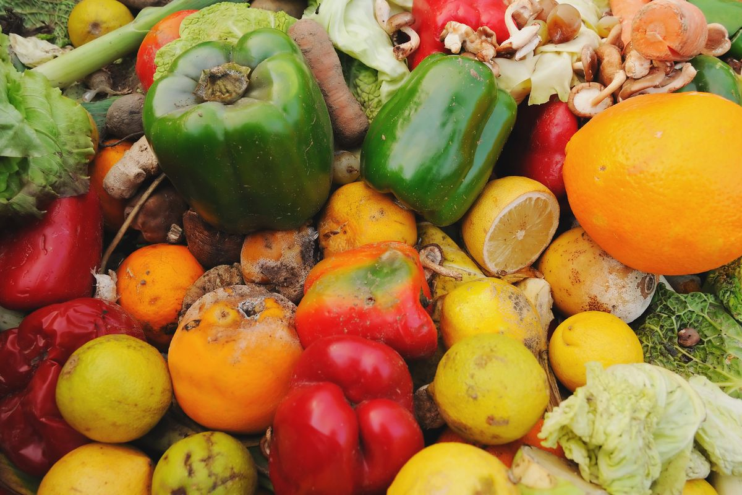
CURBING POST-HARVEST LOSSES IN AGRICULTURE.
DR. KAREEM-IBRAHIM, K. O
Department of Animal Science.
SCHOOL OF AGRICULTURE, LAGOS STATE UNIVERSITY.

Slide 2
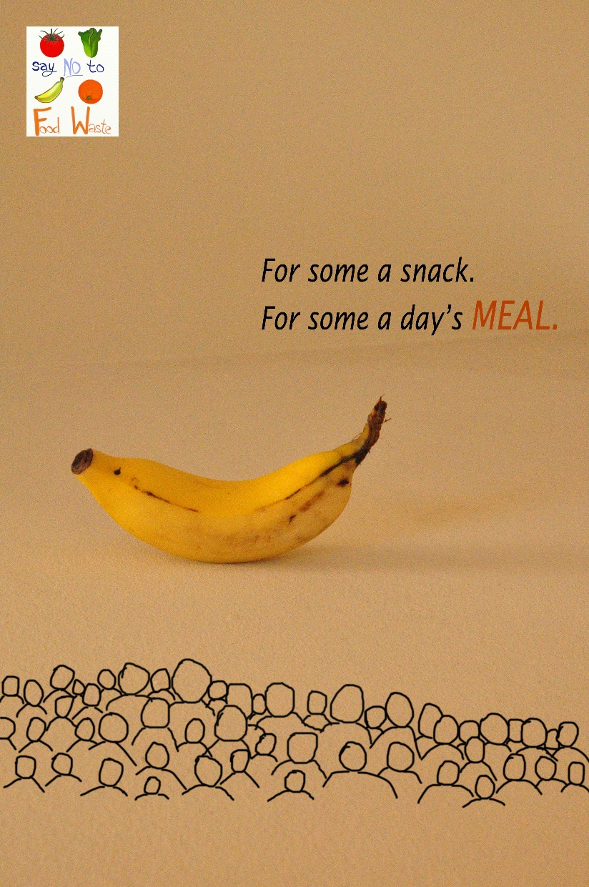
FOOD SECURITY
Food security is one of the main global challenges today
World population has been predicted to reach 10.5 billion by 2050 (United Nations, 2013)
Food production needs to grow by 70 % to cater for world population growth (Kiaya, 2014)
There’s a need for an integrated and innovative approach to ensuring sustainable food production
Image source: Pinterest

Slide 3
FOOD SECURITY
One of the major ways of strengthening food security is by reducing food losses
Food security in Nigeria, and indeed Africa is inadequate
Food wastage in tropical weather such as Nigeria is as high as 40 – 50 % (FIIRO, 2017)
“ Respect for food is a respect for life, for who we are and what we do” – Thomas Keller

Slide 4
WHAT IS POST-HARVEST LOSS ?
Post-harvest loss (PHL) refers to measurable quantitative and qualitative food loss in the post-harvest system (de Lucia and Assennato, 1994).
This system comprises interconnected activities from the time of harvest through processing, marketing and food preparation

Slide 5
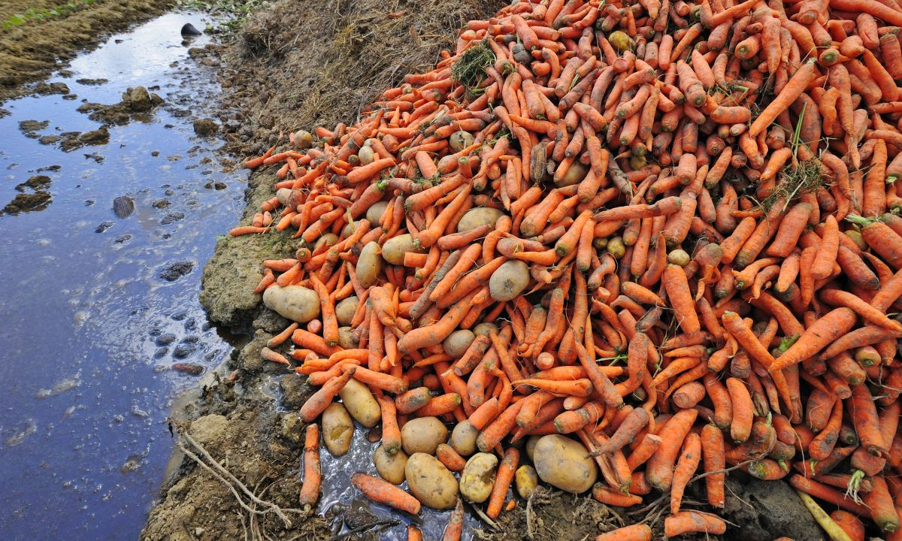
FOOD LOSS
Image source: Pinterest

Slide 6
CAUSES OF POST-HARVEST LOSS
Post-harvest handling
Lack of storage & processing facilities
Seasonal farming
Inadequate social infrastructures
Inadequate market information
Reduced use of relevant technologies

Slide 7
POST-HARVEST LOSS
Image from financial nigeria.com

Slide 8
STAGE | EXAMPLES OF WASTES
1. Harvesting, handling at harvesting | Edible crops left in field, ploughed into soil, eaten by pests; timing of harvest not optimal; crop damaged during harvesting
2. Threshing | Loss due to poor technique
3. Drying, transport and distribution | Quality and quantity loss of during drying, poor transport infrastructure; loss owning to spoiling/bruising
4. Storage | Pests and disease attacks, spillage, contamination; natural drying out of food
5. Primary processing, cleaning, classification, hulling, pounding, grinding, packaging, soaking, winnowing, drying, sieving, milling | Process losses; contamination in process causing loss of quality
Parfait et al., 2010

Slide 9
THE NATURE & SOURCE OF LOSSES IN BEEF PRODUCT CHAIN
Source post-harvest.nri.org

Slide 10
WAY FORWARD: ROLE OF THE FARMERS
Growing varieties of crops that are tolerant to the prevailing climatic conditions
Adopting better agronomic practices that increase soil moisture-holding capacity
Soil erosion protection measures
Embracing mechanized farming
Practicing proper post-harvest handling
Investing in integrated farming

Slide 11
WAY FORWARD: ROLE OF THE GOVERNMENT
Provision of necessary infrastructure
Improving access to markets
Improving ICT use in agriculture
More focus on value addition
Provision of proper storage facilities of produce
Better agricultural policies and incentives to farmers

Slide 12
WAY FORWARD: ROLE OF THE POPULACE
Reduce
Reduce food wastage at home
Identify
Identify the needy around
Love
Love all produce the same
Employ
Employ various cooking methods
Eat
Eat balanced diet
Key
Key into opportunities that abound in the agricultural sector

Slide 13
FOOD FOR THOUGHT
“ An agro-value chain can reduce poverty two to four times faster than any other sector which, when amalgamated with clean energy to power agro-value addition industries, can build a $1 trillion agro sector and create over 17 million jobs along the entire agro-value chain.”
- Dr Richard Munang of the United Nations, environment & climate change.

Slide 14
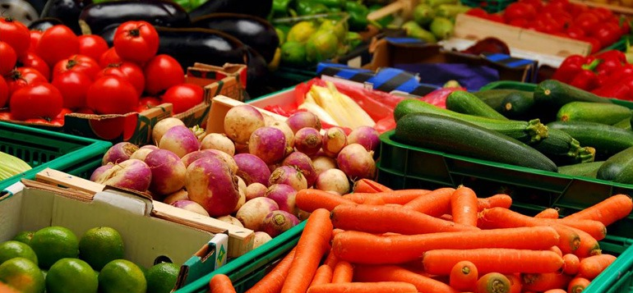
THANK YOU.

